Slide 1
Hand Gesture Recognition
Group 16:
2440007226 - Eduardo Brilliandy
2440016672 - Javier Islamey

Slide 2
Introduction
Hand gesture recognition provides convenience and accessibility for users by adding a new method of interaction with technology. It can also be useful for recognizing sign languages.
To do this task, a Convolutional Neural Network model is used to classify the several different hand gestures.

Slide 3
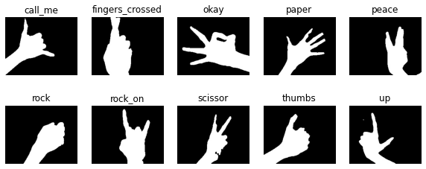
Dataset
The dataset used is obtained from Kaggle and it consists of 5243 images of 10 different hand gestures (classes). Each gesture has around 500 images.

Slide 4
Method

Slide 5
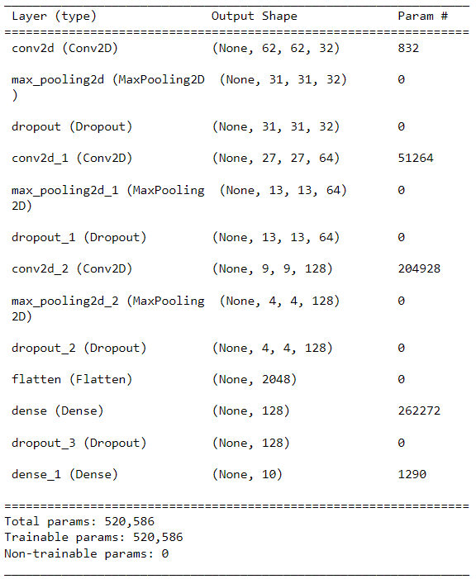
Results
The CNN model performed well when evaluated using the testing data. The model achieved a high accuracy of 0.982 and a loss of 0.073.

Slide 6
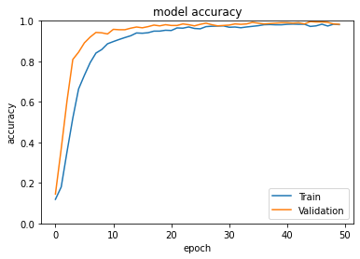
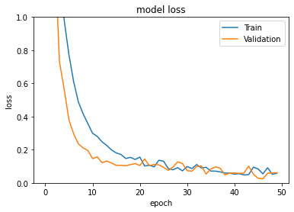
Results

Slide 7
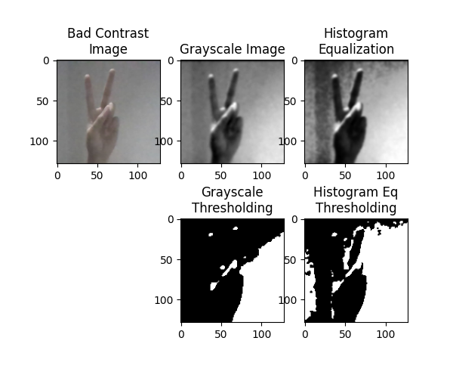
Implementation
The binary thresholding does not work well when given a bad contrast image

Slide 8
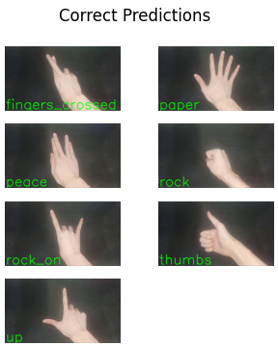
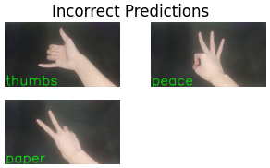
Implementation

Slide 9
Conclusion
In conclusion, using CNN model to classify different hand gestures performs decently well. However, the model struggles to differentiate between similar hand gestures.
To improve, a better method to separate foreground and background could be used. Additionally, a deep neural network model such as ResNet or AlexNet could be tested.

Slide 10
THANK YOU

